Slide 1
PC Maintenance: Preparing for A+ Certification
Chapter 26: Selecting and Installing an Operating System

Slide 2
Chapter 26 Objectives
Define functions of an OS
Identify major system files and features of DOS, Windows 3.1, 9x, NT, 2000, XP
Install the above operating systems
Troubleshoot installation problems

Slide 3
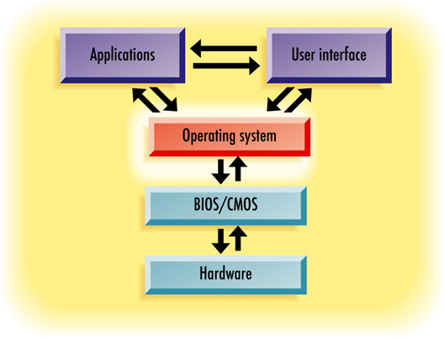
Functions of an OS
Communicates between applications and BIOS/hardware
Provides a user interface to the user
Enables user interface and applications to interact

Slide 4
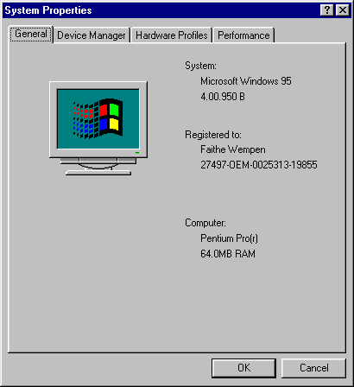
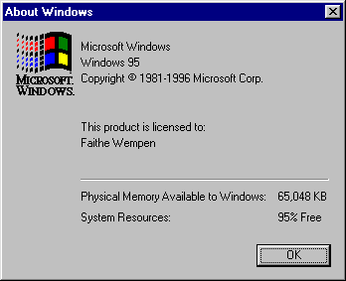
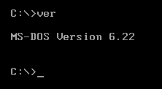
Checking the Current OS Version
Command prompt: VER command
In Windows: Choose Help > About Windows from any file management window

Slide 5
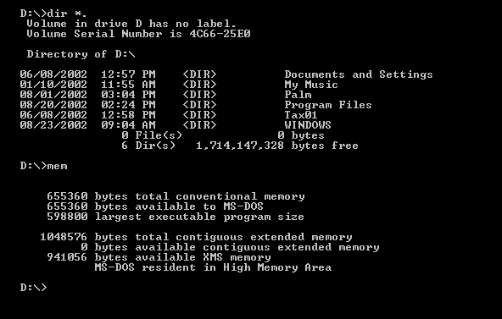
MS-DOS
Command prompt interface
No GUI
Single-user, single-tasking

Slide 6
MS-DOS Commands
Internal commands
  Built into COMMAND.COM, the command interpreter application
External commands
  Exist as separate applications in the C:\DOS folder

Slide 7
MS-DOS Major System Files
COMMAND.COM
  Command interpreter
  Present in top-level folder of boot drive
MSDOS.SYS and IO.SYS
  Hidden, system files in top level folder of boot drive
AUTOEXEC.BAT and CONFIG.SYS
  Optional configuration files
  Store settings that load at boot

Slide 8
MS-DOS Major System Files
HIMEM.SYS
  Extended memory manager, to access memory above 1MB
EMM386.EXE
  Expanded memory manager
SMARTDRV
  Disk caching utility, for better performance

Slide 9
Windows 3.x
First commercially successful version of Windows
3.x refers to Windows 3.0, Windows 3.1, and Windows 3.11 for Workgroups
16-bit application
Runs on top of MS-DOS (DOS is required)

Slide 10
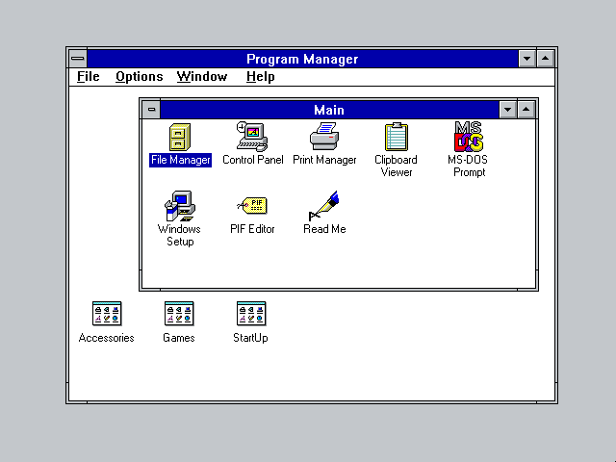
Windows 3.1

Slide 11
Windows 3.1 Major System Files
Basic set from MS-DOS
  IO.SYS, MSDOS.SYS, COMMAND.COM, HIMEM.SYS
WIN.COM
  Executable file that starts Windows
Windows System files
  GDI.EXE: Graphical interface
  KRNL386.EXE: Memory management
  USER.EXE: User input and output

Slide 12
Introducing DLLs
DLL: Dynamic Link Library
Libraries of programming routines that applications can call upon
Execute standard functions
Some come with Windows
Others come with specific applications
Still the cornerstone of Windows applications today

Slide 13
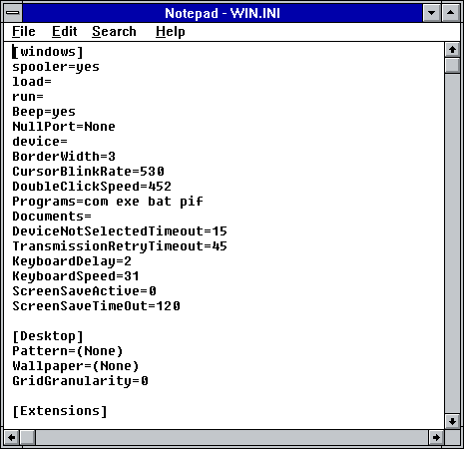
Windows 3.1 Configuration
Precursor to the Windows Registry
SYSTEM.INI for system settings
WIN.INI for application settings

Slide 14
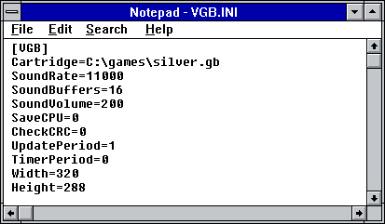
Introducing INI Files
Initialization files
Run when the corresponding application is started
Contain startup settings for that application
Better to have a separate file than to try to store setting for all installed applications in WIN.INI

Slide 15
Features of Windows 3.x
Memory allocation
  Protected-mode application
  Able to access extended memory and make it available to the applications
Common device drivers
  One driver for each piece of hardware, regardless of the applications that use it

Slide 16
Features of Windows 3.x
TrueType fonts (3.1)
  Scaleable outline fonts that work with any printer
Virtual memory
  Extra RAM can be simulated by using part of hard disk
Virtual machines
  More than one program can run at once in its own address space

Slide 17
Features of Windows 3.x
Data sharing:
  Windows clipboard
  Dynamic Data Exchange (DDE), precursor to the more modern OLE we use today
Cooperative multitasking
  Applications share CPU time
  Each application voluntarily pauses to allow others to run

Slide 18
Windows 95, 98, and Me
Collectively referred to as Windows 9x
Includes:
  Windows 95 (several service pack versions)
  Windows 98
  Windows 98 Second Edition
  Windows Millennium Edition (Me)

Slide 19
Windows 95, 98, and Me
A real operating system
Does not rely on MS-DOS (well, not much)
Still uses some DOS underpinnings, but they are transparent to most users

Slide 20
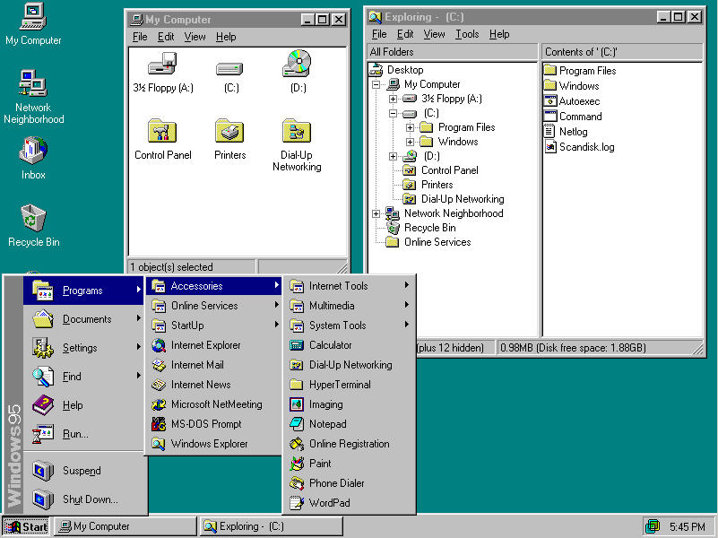
Windows 9x User Interface

Slide 21
Windows 9x Major System Files
IO.SYS: The main startup file
MSDOS.SYS: Now just a configuration file
COMMAND.COM: Required for command line interface
HIMEM.SYS: Extended memory manager

Slide 22
Windows 9x Major System Files
Carryovers from Windows 3.1 (not required, but used if they are present)
  AUTOEXEC.BAT and CONFIG.SYS
  WIN.INI and SYSTEM.INI
16-bit system files (for backward compatibility
  GDI.EXE: Graphical interface
  KRNL386.EXE: Memory management
  USER.EXE: User input and output

Slide 23
Windows 9x Major System Files
WIN.COM
  The main Windows program
32-bit program files:
  KERNEL32.DLL: Memory manager
  USER32.DLL: User input and output
  GDI32.DLL: Graphical interface
VMM386.VXD
  Loads the 32-bit device drivers

Slide 24
Windows 9x Features
Application compatibility
  Can run both 16-bit (Windows 3.x) and 32-bit applications
Plug and Play hardware detection
Preemptive multitasking
  Uses time slices to prevent rogue programs from locking up the system

Slide 25
Windows 9x Registry
System settings for startup
SYSTEM.DAT and USER.DAT files
From the Registry Editor, they appear to be a single database

Slide 26
Windows 9x Features
Object Linking and Embedding (OLE)
  Data transfer between applications
  Superior to the earlier DDE
Safe Mode
  Allows startup when PC cannot start Windows normally
Long file names
  Up to 255 characters, including spaces

Slide 27
Windows 9x Versions
Version | Number | Distribution | Features
Windows 95 | 4.00.950 | Retail, OEM
Windows 95 SP1 | 4.00.950A | Retail, OEM, Patch | Bug fix
Windows 95 SR2 | 4.00.1111 | OEM only | FAT32, IE, NetMeeting, DirectX
Windows 95 SR2.1 | 4.03.1212.1214 | OEM only | USB
Windows 95 SR2.5 | 4.03.1214 | OEM only | OE, Internet Connection Wizard
Windows 98 | 4.10.1998 | Retail, OEM | Disk Cleanup, System Information, Drive Converter, Maintenance Wizard
Windows 98 Second Edition | 4.10.2222A | Retail, OEM | Internet Connection Sharing
Windows Me | 4.90.3000 | Retail, OEM | System Restore, Home Networking Wizard, Windows Movie Maker

Slide 28
Windows NT, 2000, and XP
“The NT Platform”
For business use
32-bit OS
GUI and OS built together, no DOS underpinnings
Cannot boot OS to a command prompt from a floppy (as with Win9x)

Slide 29
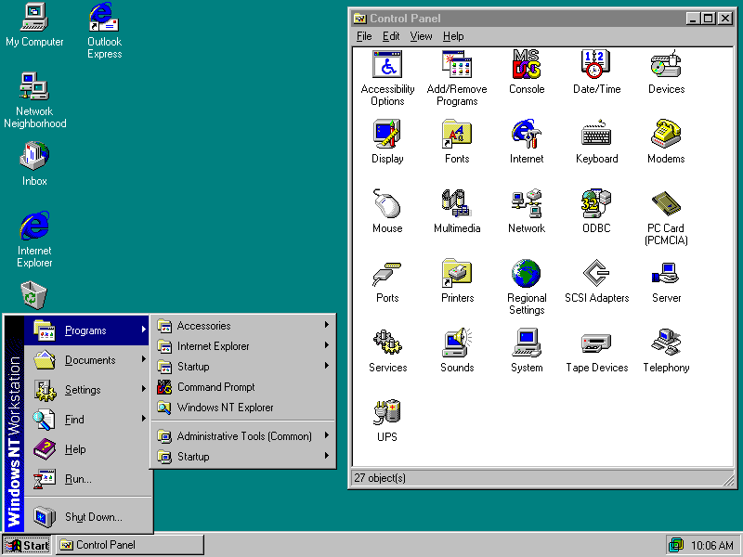
Windows NT 4.0 User Interface

Slide 30
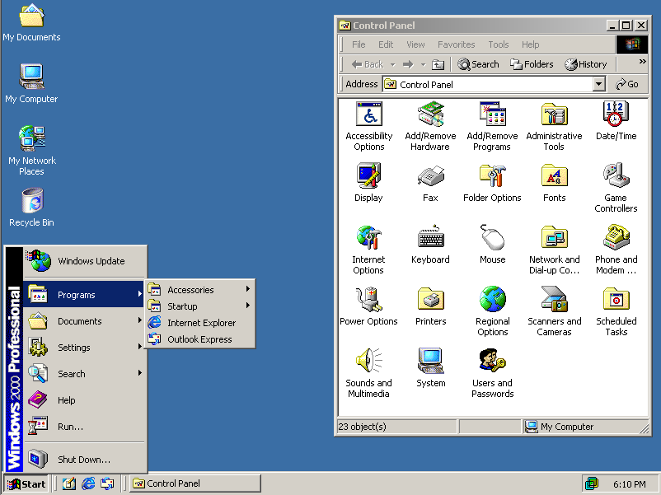
Windows 2000 User Interface

Slide 31
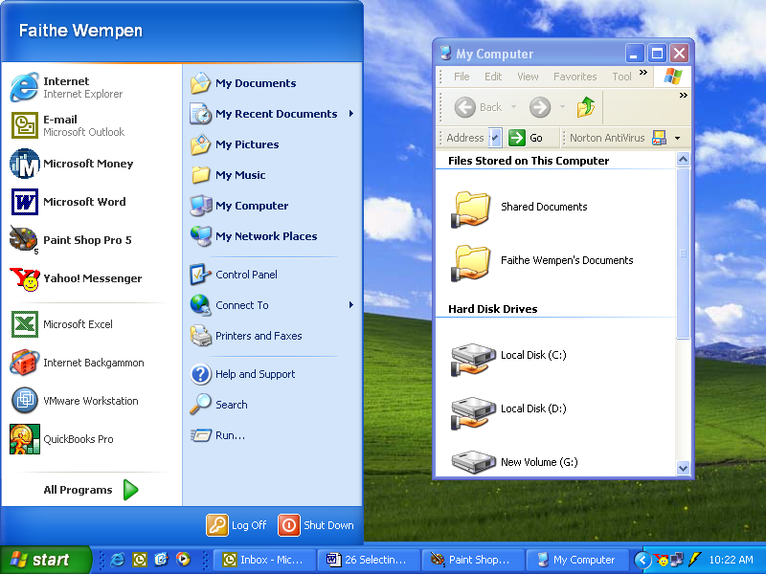
Windows XP User Interface

Slide 32
NT Platform Major System Files
NTLDR (NT Loader)
  Equivalent to IO.SYS in Win9x
  Loads the operating system
NTDETECT
  Checks the hardware
BOOT.INI
    Initialization file similar to MSDOS.SYS

Slide 33
NT Platform Major System Files
WINNT32.EXE
  Main program file for Windows
NTOSKRNL.EXE (NT OS Kernel)
  The equivalent of Krnl386.exe in earlier versions
HAL.DLL (Hardware Abstraction Layer)
  A dynamic link library that helps communicate between the hardware and the OS

Slide 34
NT Platform Major System Files
NTUSER.DAT
  User information for each user (separate)
  Windows NT/2000: Stored in \Winnt\Profiles\username
  Windows XP: Stored in \Windows\Profiles\username

Slide 35
NT Platform Registry
Windows NT/2000:
  Stored in \Winnt\System32\Config
Windows XP:
  Stored in \Windows\System32\Config

Slide 36
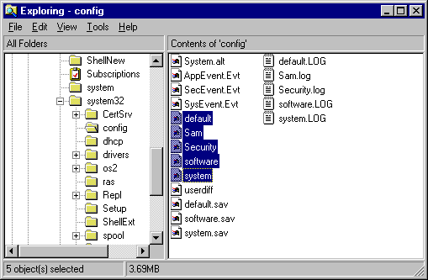
NT Platform Registry
Registry Hives
  Sam
  Security
  System
  Software
  Default
Log files (*.log) for each
Backup files (*.sav) for each

Slide 37
Windows NT 4 Features
NTFS file system (NTFS 4)
Improved networking
Better security
Server version
Multiple CPU support
Support for non-PC hardware (ex. DEC Alpha workstation)

Slide 38
Windows 2000 Features
Plug and Play
NTFS 5 and support for FAT32
Dynamic disks
Active Directory
Internet Printing protocol
Microsoft Management Console
Administrative tools

Slide 39
Windows XP Features
Utilities from Windows Me
  Windows Media Player
  Windows Movie Maker
  System Restore
  Scanner and Camera Wizard
Friendlier logon (Welcome screen)
Fast User Switching
Driver signing and roll-back

Slide 40
Windows XP Features
Internet Connection Firewall
Wireless networking
Remote desktop

Slide 41
Window XP Home vs. Professional
Multiple CPU support
64-bit CPU support
Advanced security features
File encryption (EFS)
Personal Web server
Remote desktop connection
Membership in a domain
Dynamic disks
Microsoft Backup and ASR

Slide 42
Preparing to Install an OS
Check system requirements
Plan how you will start the Setup program
Decide whether you will upgrade or do a clean install
Plan for multi-booting

Slide 43
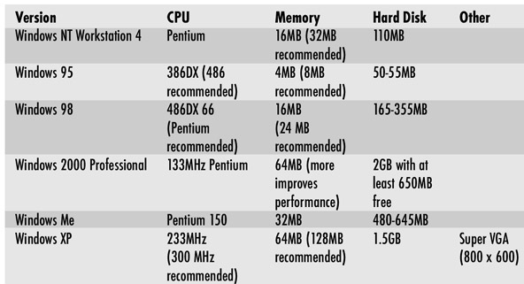
OS System Requirements

Slide 44
Starting the Setup Program
Start from a startup floppy
  Possible only if existing OS is MS-DOS or Windows 9x
  Desirable only if installing Windows 9x/Me
Boot from the Windows CD
  Possible on all existing OS systems
  Possible only if installing Windows NT/2000/XP

Slide 45
Starting the Setup Program
Copy Setup files to hard disk and install from there
  Keeps OS files handy so CD will not be needed in the future
  Takes up space on the hard disk
Install from Network
  Existing network connection must be present, or must set up real-mode boot disk with network drivers

Slide 46
Planning an OS Upgrade
Hardware
  Is all the hardware on the Hardware Compatibility List (HCL)?
  Does the system meet the minimum requirements?
Existing OS
  Is the existing OS upgradeable to the desired new version?
Software
  Are all existing applications able to run under new OS version?

Slide 47
Clean Install?
Is it necessary to preserve existing application installations?
Is it necessary to preserve existing data files?
Does the old OS have performance problems that might be corrected by a clean install of the new OS?
Do you want to redo the partitions on the hard disk?

Slide 48
Planning for Multi-Booting
Windows NT 4, 2000, and XP are all multi-boot aware; Windows 95, 98, and Me are not
  Install the non-multi-boot-aware OS first
  Install the multi-boot-aware OS afterward, on a different logical drive
Settings for multi-booting are stored in BOOT.INI

Slide 49
Special Upgrading Issues
DOS to Windows 9x
  Disable any 3rd party memory management utilities, disk caches, antivirus
NT/2000/XP to 9x
  Not a directly supported upgrade path
  Clean install only
9x to NT/2000/XP
  Check device compatibility, driver updates may be required

Slide 50
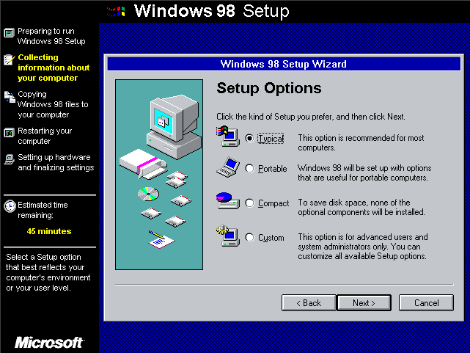
Installing Windows 9x
Start Setup from CD or from files copied to hard disk

Slide 51
Installing Windows NT, 2000, or XP
Boot from the Windows CD
Create setup boot disks if needed
  Useful if PC does not support booting from CD
  x:\bootdisk\makeboot a:

Slide 52
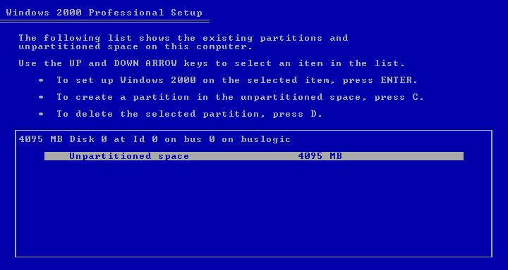
Partitioning and Formatting
Setup creates FAT or NTFS partitions
Both partitions and formats

Slide 53
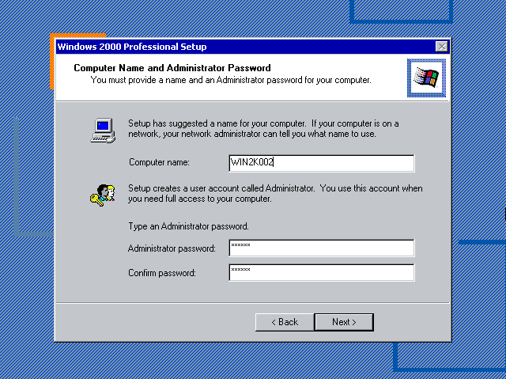
Computer Name and Administrator Password
Very important to remember the password you use here
Password will be required to get into Recovery Console

Slide 54
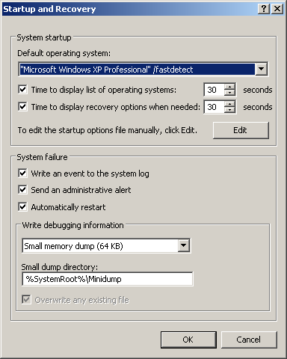
Managing Multi-Boot Settings
Control Panel method:
  System Properties, Advanced tab, Startup and Recovery Settings
Alternate method:
  Edit BOOT.INI in Notepad

Slide 55
Troubleshooting Installation Problems
Hardware incompatibilities
  Check HCL (www.microsoft.com/hcl)
  Remove all non-essential hardware for the install
  Check device manufacturer’s Web site for firmware or driver updates
Cannot get past Scandisk
  Run setup with /is switch: setup /is

Slide 56
Troubleshooting Installation Problems
Errors reading from CD
  Remove the CD, rotate it, try again
  Clean dirt and fingerprints off CD with soft dry cloth
  Copy setup files from CD to hard disk and install from there
  Try a different CD drive if possible

Slide 57
Troubleshooting Installation Problems
File missing after installing
  Use EXTRACT utility to copy needed file from CD:
  EXTRACT x:\path\cabinetfile x:\path\filename
  Search all CAB files with the /A switch:
  EXTRACT /A x:\path\cabinetfile x:\path\filename

